Slide 1
Semidefinite Relaxations in Robust Rotation Search: Tight or Not
Liangzu Peng (lpeng25@jhu.edu)
@ICCOPT, Bethlehem, Pennsylvania
Joint Work with Mahyar Fazlyab and Rene Vidal
Johns Hopkins University
Presentation Date: July 26, 2022

Slide 2
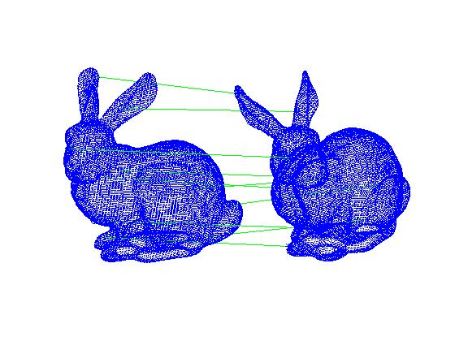
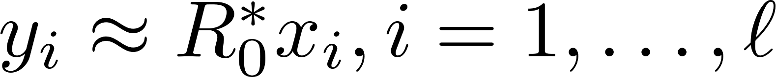

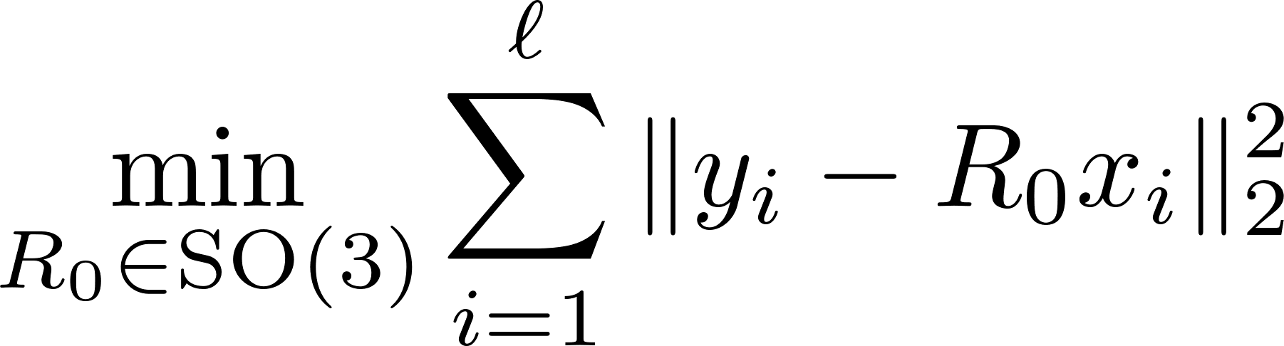
Rotation Search (Wahba’s Problem）
Wahba’s Problem
(Wahba, 1965)
G. Wahba. A least squares estimate of satellite attitude.
SIAM Review, 1965

Slide 3
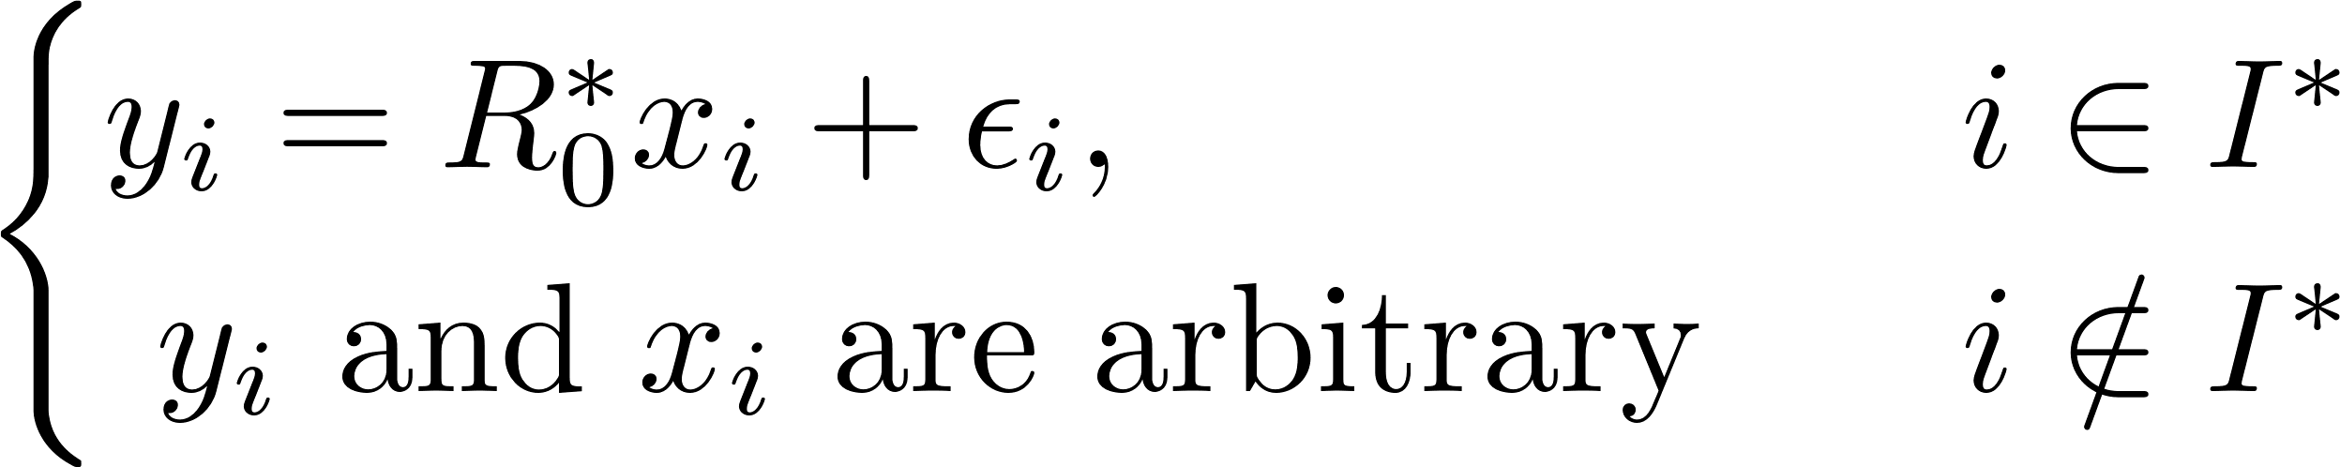
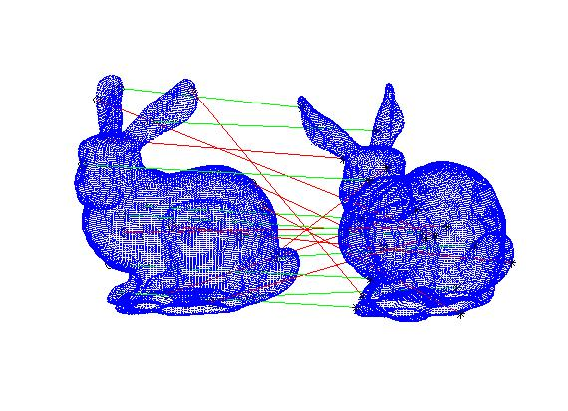
(Outlier-)Robust Rotation Search

Slide 4
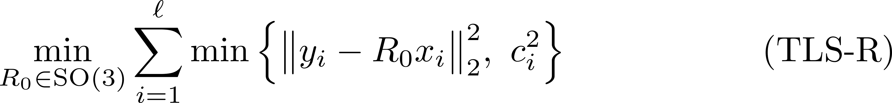
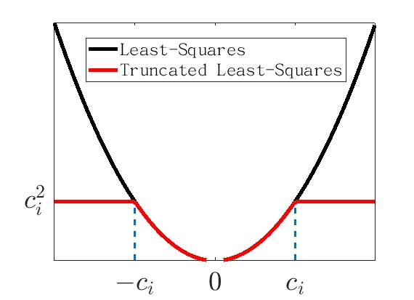
Truncated Least-Squares (Rotation)
H. Yang and L. Carlone. A quaternion-based certifiably optimal solution to the Wahba problem with outliers. ICCV 2019.

Slide 5
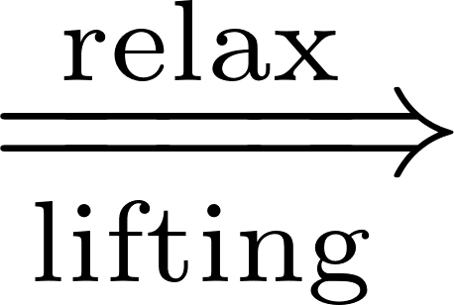

Overview 1/2
1. From (TLS-R) to Its Semidefinite Relaxations
We will derive (based on Yang & Carlone [1]):
(TLS-R) (TLS-Q) (QCQP) (SDR)
Rotation “replaced” by Unit Quaternion
[1] H. Yang and L. Carlone. A quaternion-based certifiably optimal solution to the Wahba problem with outliers. ICCV 2019.

Slide 6

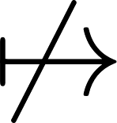
Overview 2/2
2. Tightness of (SDR): mi casa es su casa?
(TLS-R) (TLS-Q) (QCQP) (SDR)
We provide conditions, under which:
global minimizer of (SDR) global minimizer of (QCQP)
or equivalently (SDR) is tight or not
L. Peng, M. Fazlyab, R. Vidal, Semidefinite relaxations of truncated least-squares in robust rotation search: Tight or not, ECCV 2022

Slide 7
Overview 3/3
3. Discussion
(TLS-R) (TLS-Q) (QCQP) (SDR)
Summary with several possible extensions
An open problem that arises in our analysis
(if time permits) (open = I can not solve it)
L. Peng, M. Fazlyab, R. Vidal, Semidefinite relaxations of truncated least-squares in robust rotation search: Tight or not, ECCV 2022

Slide 8

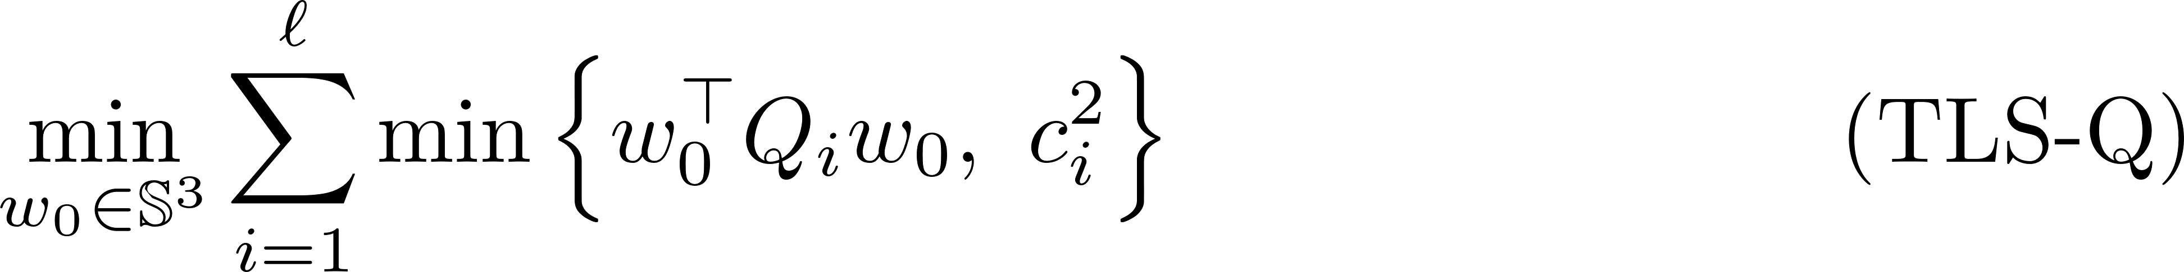
From (TLS-R) to (TLS-Q)
(TLS-R) (TLS-Q) (QCQP) (SDR)
Change of
Optimization
Variables
Change of Data and Residual

Slide 9
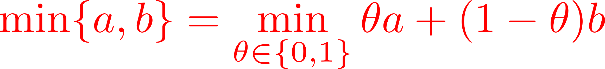
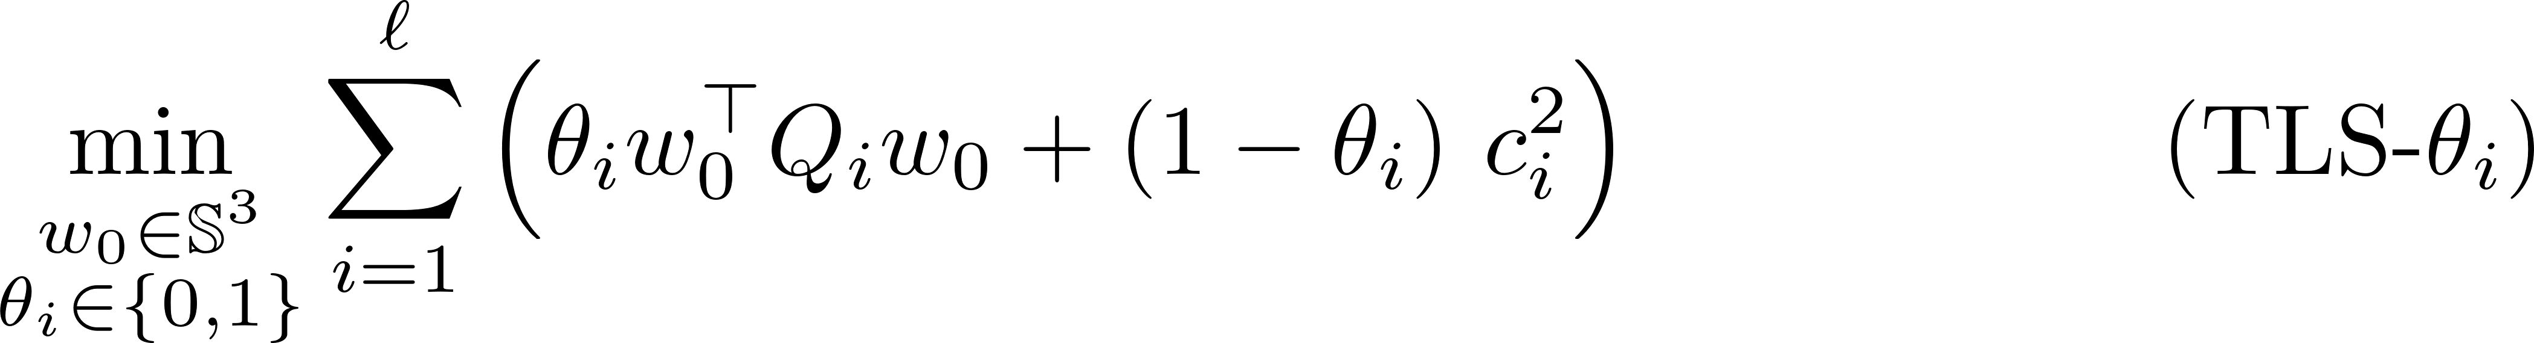
From (TLS-Q) to (QCQP) 1/4
(TLS-R) (TLS-Q) (QCQP) (SDR)
cubic polynomial in entries of the unknowns

Slide 10
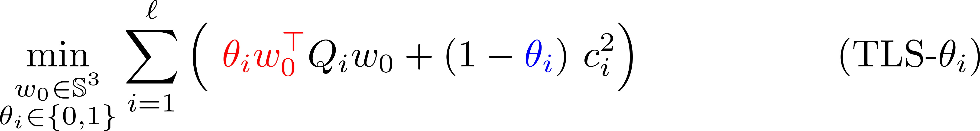
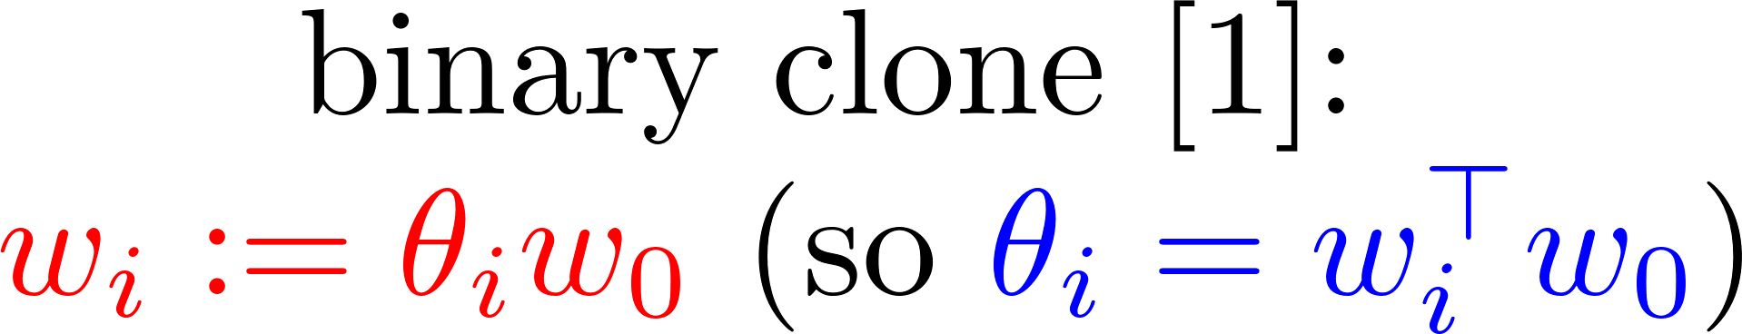
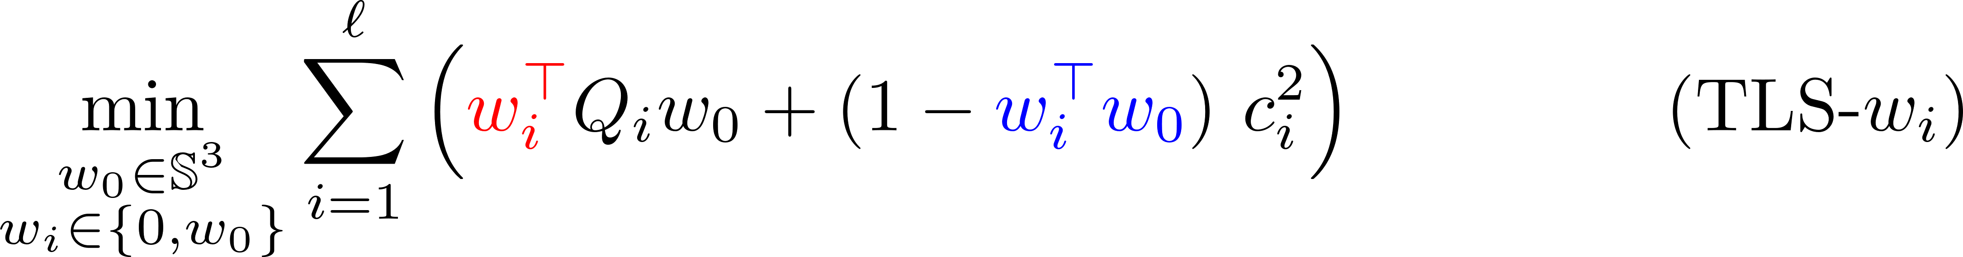
From (TLS-Q) to (QCQP) 2/4
(TLS-R) (TLS-Q) (QCQP) (SDR)
Quadratic Obj.
[1] H. Yang and L. Carlone. A quaternion-based certifiably optimal solution to the Wahba problem with outliers. ICCV 2019.

Slide 11
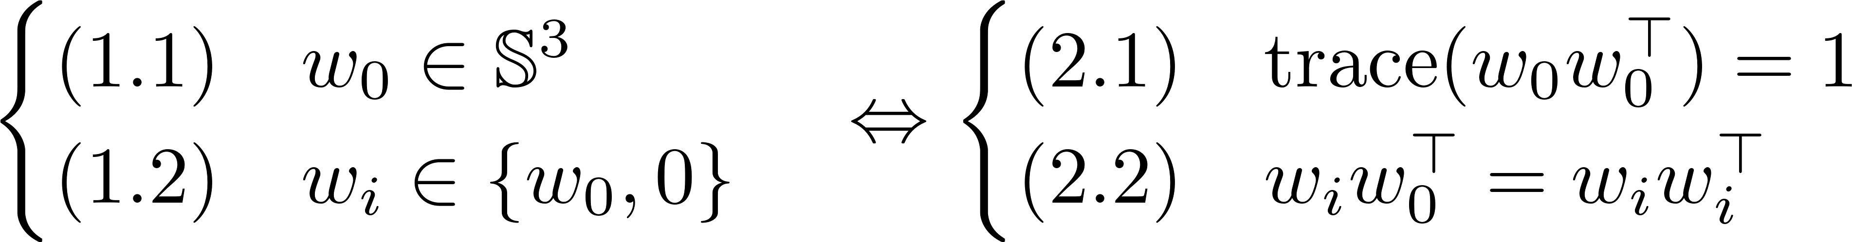
From (TLS-Q) to (QCQP) 3/4
(TLS-R) (TLS-Q) (QCQP) (SDR)
Quadratic Obj.
Constraints are also quadratic:

Slide 12
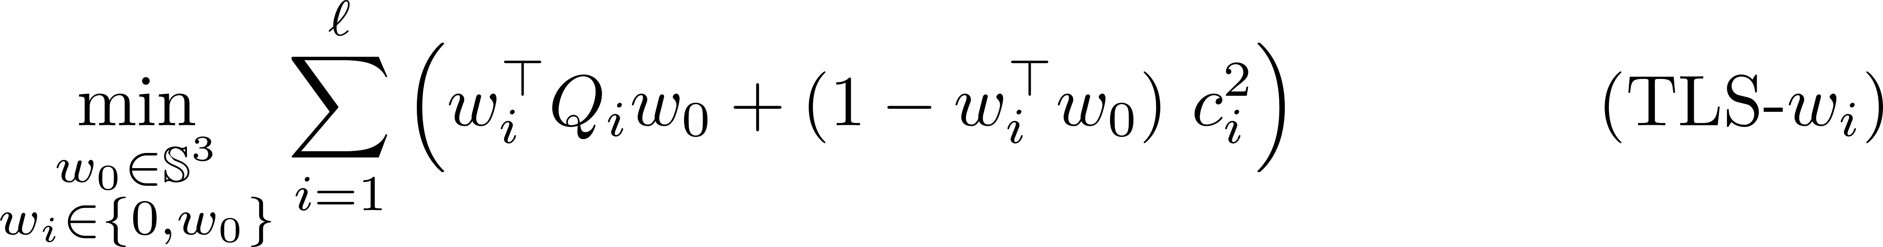
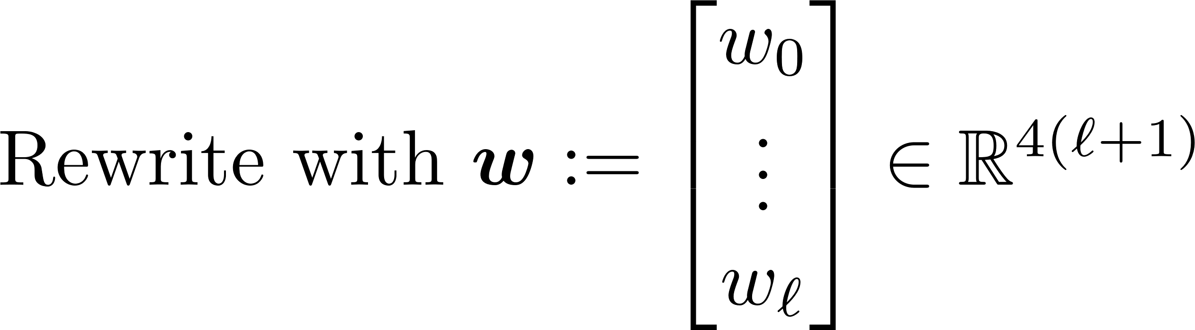
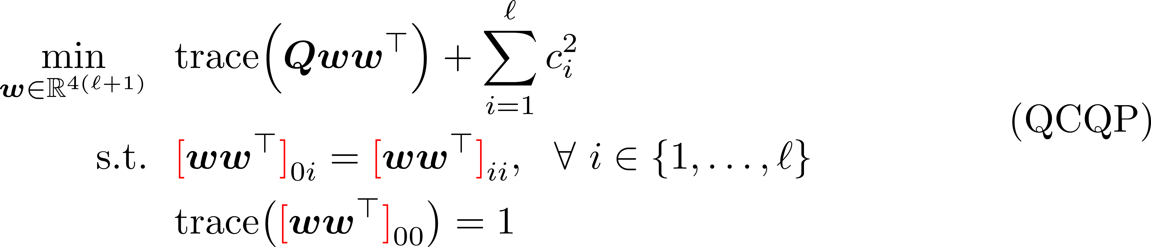
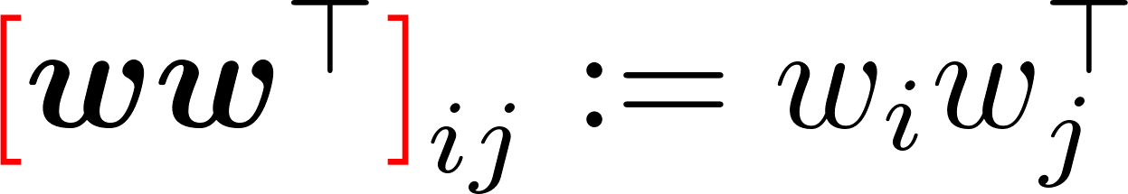
From (TLS-Q) to (QCQP) 4/4
(TLS-R) (TLS-Q) (QCQP) (SDR)
Change of Data

Slide 13

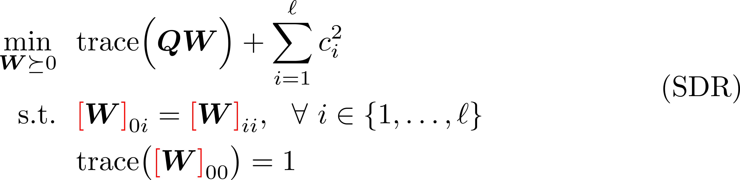
From (QCQP) to (SDR)
(TLS-R) (TLS-Q) (QCQP) (SDR)
Lifting

Slide 14

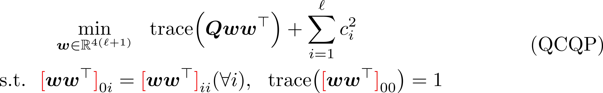
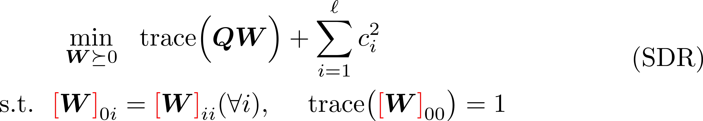
Interim Summary
Rotation Unit Quaternion
Binary Cloning
Lifting

Slide 15
Tightness of (SDR) 1/7
Definition (Tightness, mi casa es su casa):
(TLS-R) (TLS-Q) (QCQP) (SDR)

Slide 16
Tightness of (SDR) 2/7
Structure of Our Theorems:
(TLS-R) (TLS-Q) (QCQP) (SDR)
Theorem 2
w/o noise
w/ outliers
Theorem 1
w/o noise
w/o outliers
Theorem 4
w/ noise
w/ outliers
Theorem 3
w/ noise
w/o outliers
[1] H. Yang and L. Carlone. A quaternion-based certifiably optimal solution to the Wahba problem with outliers. ICCV 2019.

Slide 17



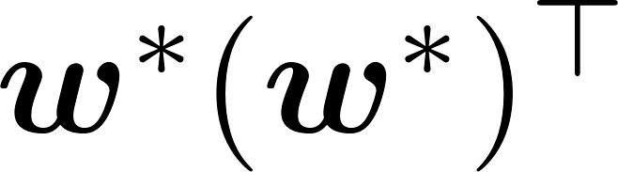
Tightness of (SDR) 3/7
Theorem 1:
(TLS-R) (TLS-Q) (QCQP) (SDR)
Ground-Truth:
Compared to [1], our proof is simpler and shorter.
[1] H. Yang and L. Carlone. A quaternion-based certifiably optimal solution to the Wahba problem with outliers. ICCV 2019.

Slide 18
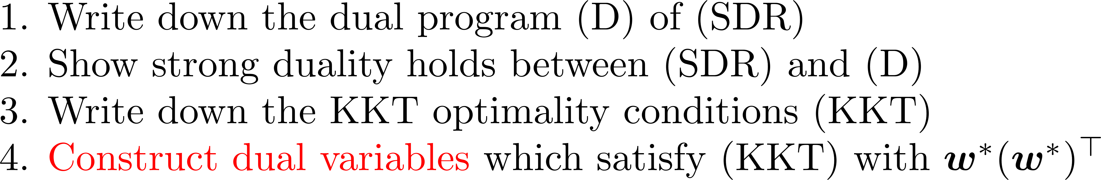
Tightness of (SDR) 4/7
Theorem 1:
(TLS-R) (TLS-Q) (QCQP) (SDR)
Ground-Truth:
High-Level Proof:
L. Peng, M. Fazlyab, R. Vidal, Semidefinite relaxations of truncated least-squares in robust rotation search: Tight or not, ECCV 2022

Slide 19
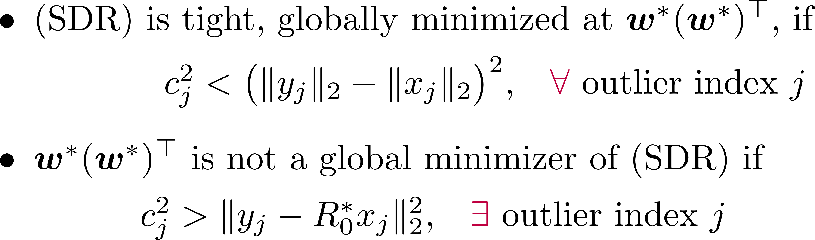
Tightness of (SDR) 5/7
Theorem 2:
(TLS-R) (TLS-Q) (QCQP) (SDR)
Ground-Truth:
Limitations: Theorem 2 does not tell
What happens if
how far the global minimizer of (SDR) is from

Slide 20
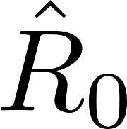


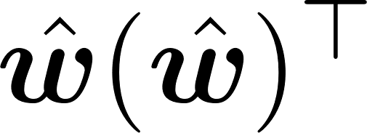
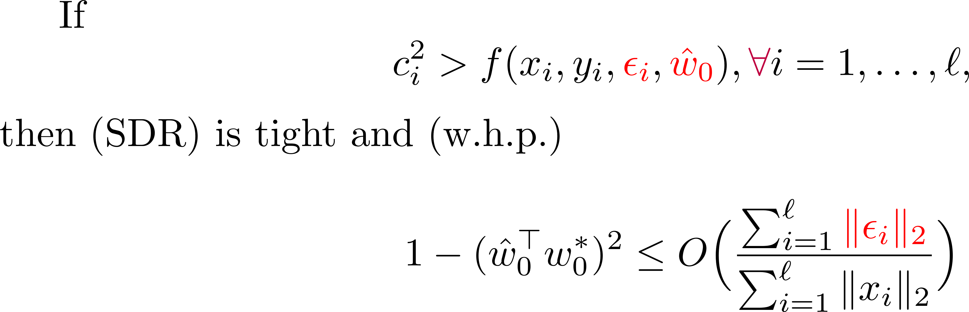
Tightness of (SDR) 6/7
Theorem 3:
(TLS-R) (TLS-Q) (QCQP) (SDR)
Ground-Truth:
Global Minimizer:

Slide 21
Tightness of (SDR) 7/7
Theorem 4:
(TLS-R) (TLS-Q) (QCQP) (SDR)
Ground-Truth:
Global Minimizer:
Suppose
the conditions of Theorem 2 hold for outlier point pairs
(noiseless + with outliers)
the conditions of Theorem 3 hold for inlier point pairs
(noisy without outliers)
Then (SDR) is tight.

Slide 22
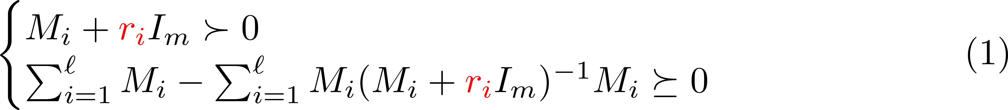

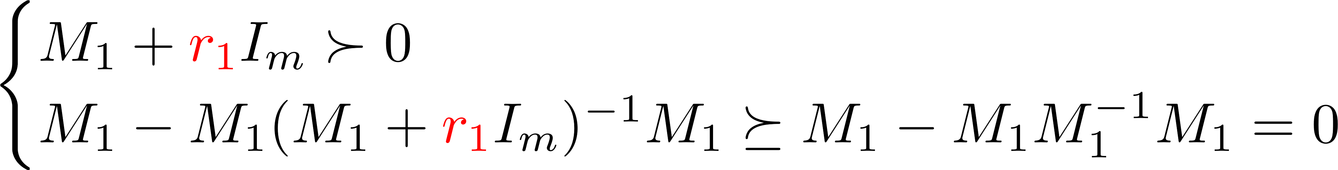
An Open Problem
Remark 1:
Remark 2:

Slide 23
Future Works
Analyze a tighter relaxation of robust rotation search [1]
E.g. at the second relaxation order of the Lasserre hierarchy
Empirically very tight, little to none theoretical justification
Extend the analysis to related geometric vision problems
Particularly for the truncated least-squares loss
See [2] for several examples
[1] H. Yang and L. Carlone. A quaternion-based certifiably optimal solution to the Wahba problem with outliers. ICCV 2019.
[2] H. Yang and L. Carlone. Certifiably optimal outlier-robust geometric perception: Semidefinite relaxations and scalable global optimization. T-PAMI 2022.
L. Peng, M. Fazlyab, R. Vidal, Semidefinite relaxations of truncated least-squares in robust rotation search: Tight or not, ECCV 2022

Slide 24
More Information
This work was supported by grants NSF 1704458, NSF 1934979 and ONR MURI 503405-78051.
Vision Lab @ JHU http://www.vision.jhu.edu
Center for Imaging Science @ JHU http://www.cis.jhu.edu
Mathematical Institute for Data Science @ JHU http://www.minds.jhu.edu
Thank You!
L. Peng, M. Fazlyab, R. Vidal, Semidefinite relaxations of truncated least-squares in robust rotation search: Tight or not, ECCV 2022

